Slide 1
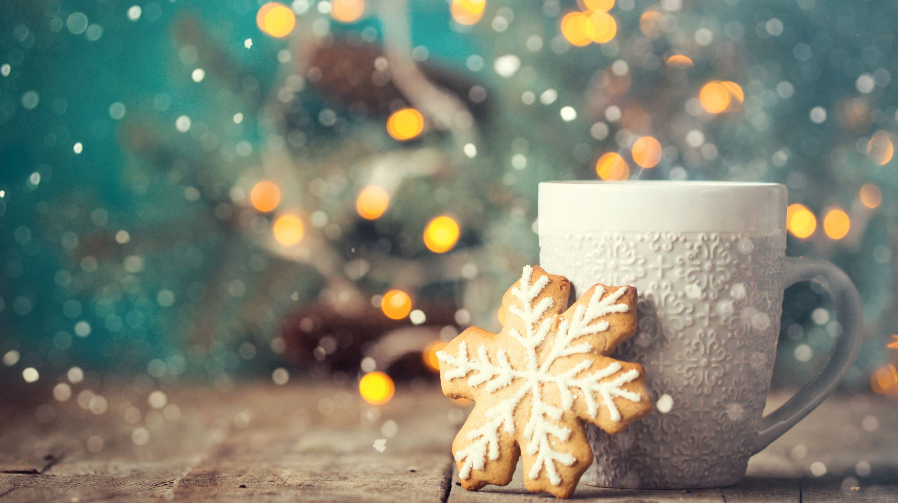
New Mug usage
1.

Slide 2
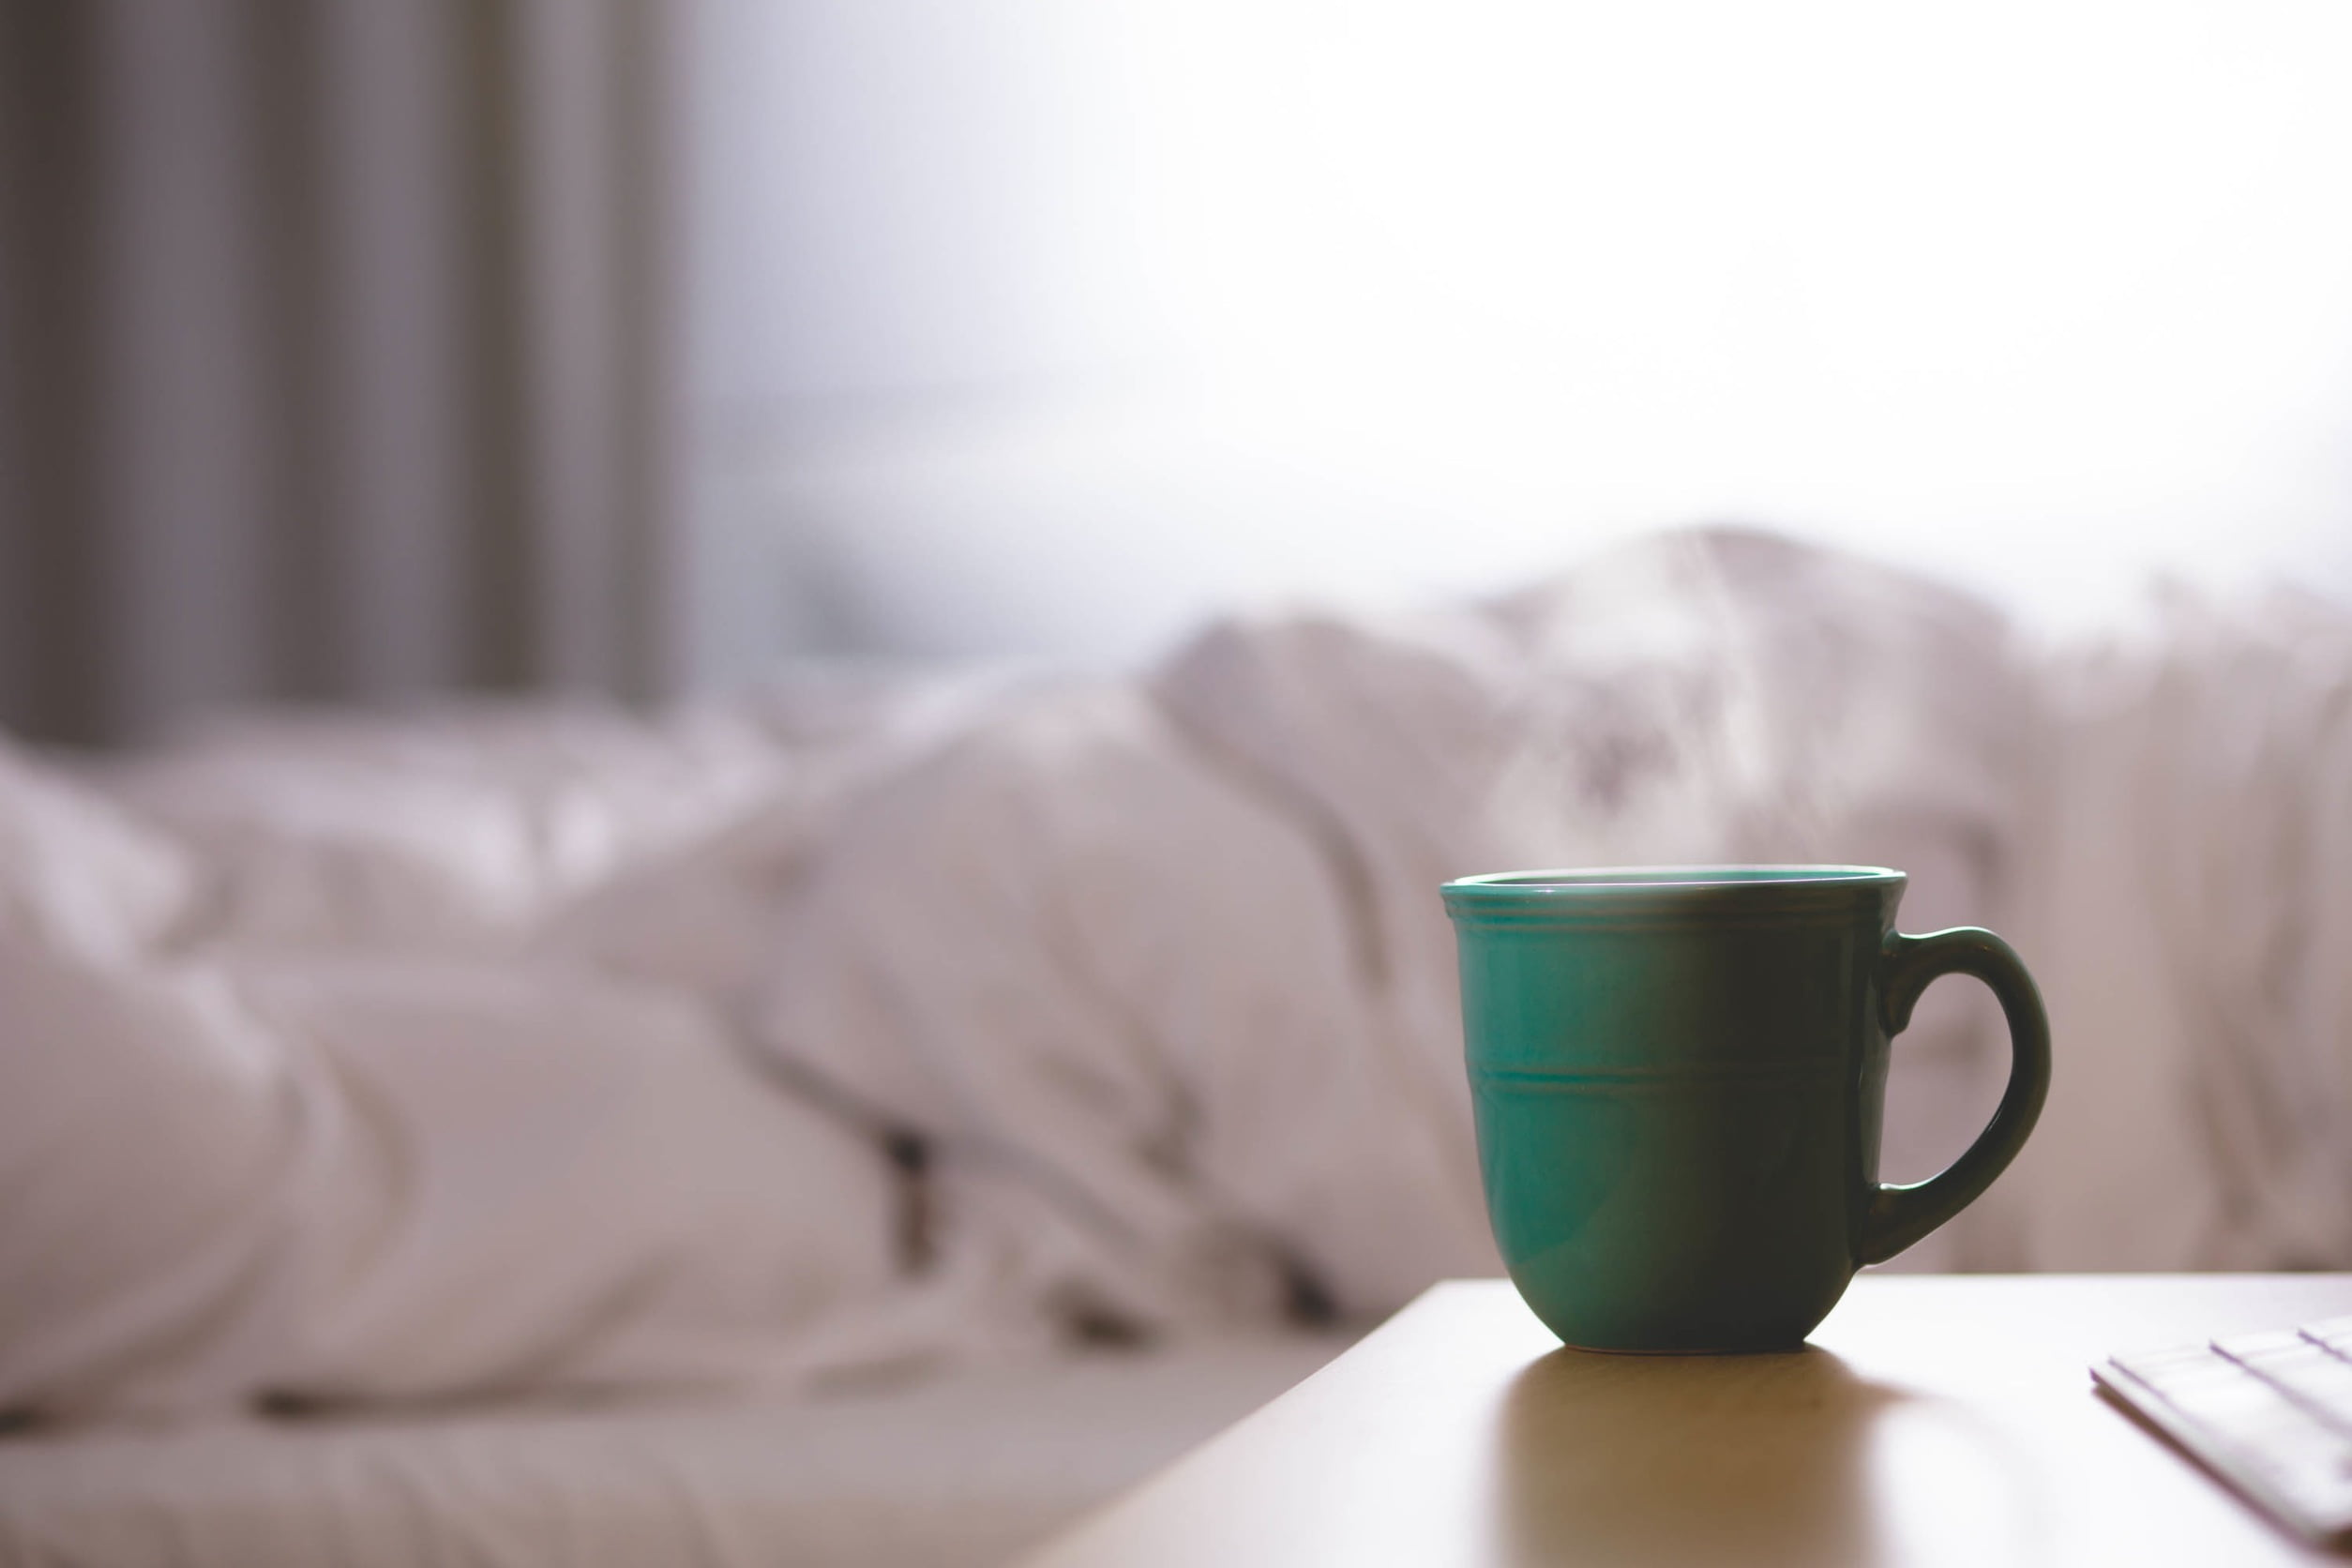
New mug usage
Flower pot
seedling starters
Pen holder
Toothbrush holder/ other toiletaries
Candle holder
Pet food scooper
Hold coin change
Hold silverware

